Slide 1


WNY Consortium of Higher Education
The Secret to College Success is:
_ _ _ _ _ _ _ _!
Steven J. Harvey, Ph.D.
Executive Director
WNY Consortium of Higher Education

Slide 2
WNY Consortium of Higher Education
Presentation Overview
My Background
Value of a College Degree
The Brutal Facts
Three Significant Disconnects
Breaking Educational and Cultural Divides
Students NEED to Change
Change is HARD
Role of Counselor: Change is HARD
Questions

Slide 3
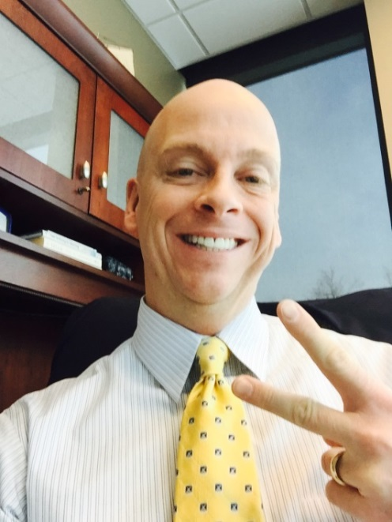
WNY Consortium of Higher Education
Background Information
Ph.D. in Educational Foundations (K-12) with Focus on Higher Education Administration, M.Ed. in Higher Education Admin., & B.S. in Business Admin.
Executive Director of WNY Consortium of Higher Education
Have taught for the past 24 years (UB, SUNY Buffalo State, & Daemen College)
Still research and publish focusing on student learning outcomes and E.I.
Entrepreneur
  CEO/Founder: The Center for Educational and Career
  Advancement, Inc. – 1992 to Present
  CEO/Co-Founder: MyCollegeMax.com, an
  innovative program that assists students with
  transitioning from high school to college and from
  college to career. 2013 to Present
Adjunct Professor, Executive Leadership & Change Dept.,
Daemen College

Slide 4

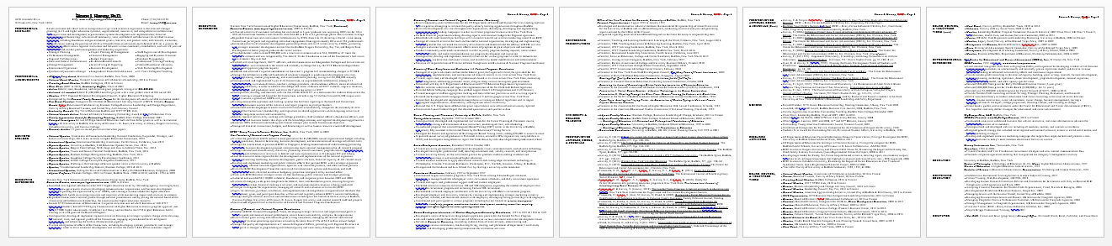



WNY Consortium of Higher Education
My Vita (fancy for Loooooong Resume)

Slide 5
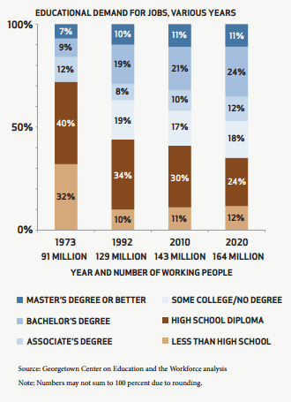
WNY Consortium of Higher Education
Need for a College Certification or Degree
More jobs will
require post-
secondary cert. or
degree in the
Knowledge
Economy!

Slide 6
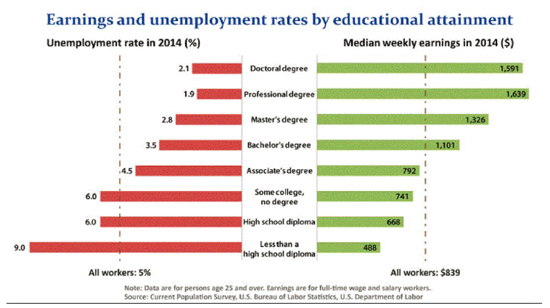
WNY Consortium of Higher Education
Value of a College Degree: Unemployment vs. Earnings

Slide 7
WNY Consortium of Higher Education
Other Values of a College Degree
Bachelor degree: earn $700,000 to $1,000,000+ more over a lifetime compared to those not having a degree (Associates: $500,000+).
According to Francis Jensen in The Teenage Brain, the final areas of the brain development during college: i.e. complex reasoning, emotional intelligence, and control; leading to higher order skill sets.
College grads live longer, are healthier & happier, stay married, have greater job satisfaction, and have greater career opportunities.
Almost every college has what students need to graduate with the skill sets and expertise they need to find the ideal job!
The best predictor of future success is not the college you attend but the major you chose. This should greatly influence where you attend college.

Slide 8

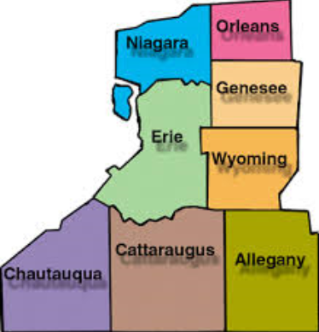
WNY Consortium of Higher Education
The Brutal Facts:
Students are not ready for college.
National Regional

Slide 9
WNY Consortium of Higher Education
Are High School Students Ready for College?
Only 21% of entering U.S. high school students graduate on time, enter college immediately, and earn an Associate's degree within three years or a Bachelor's degree within six years. (Inside Higher Ed, Nov. 17, 2015).
  Only 19 of every 100 NYS high school freshmen will earn a college degree.
  Approximately 53% of 4-year students will earn a degree in 6 years and 38% of 2-year students will earning one in 3 years (Inside Higher Ed, Nov. 17, 2015).
  What are the costs?
  According to The Four Year Myth, it costs $68,153/additional year at a 4-year public institution or $136,306 for 6 years (2016).
  Average college student loan = $37,000 plus $3,000 in credit card debt.
  According to the USDE, in 2015, most college graduates that receive financial aid make the same or less than high school graduates

Slide 10

WNY Consortium of Higher Education
Why?

Slide 11


WNY Consortium of Higher Education What are the national and state trends?
National 4-year Grad Rates:
  Increased 5 years in a row,
  Achieved a new high of 83%,
  Grad rate jumped 9 percentage points since 2006
State 4-year Grad Rates:
  Increased 8.8 percentage points since 2003 (78.1%)
  Increased 2 percentage points between 2014 and 2015
National Academic Achievement
  Nation’s Report Card: Decline in Math & ELA
  First drop in Math since 1990
  Largest drop in ELA since 1990
  ACT & SAT: Both show declining scores
  ACT: From 2010 to 2014, 1% increase from 10%
  to 11% in college readiness

Slide 12
WNY Consortium of Higher Education
Test Time!
Please do not use your phones! ;O)
Answer Key
Correct
Correct
Correct
Twice and $100 million in 2013
87 days
Unique tongue print
Left-handed (because most Muppeteers are right-handed)
38 mph
Fully grown reindeer called “Pollyanna”
“happyhour”

Slide 13
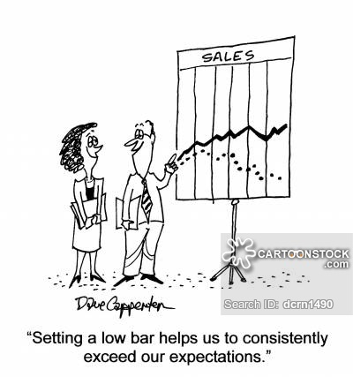
WNY Consortium of Higher Education How are students graduating high school?
NYS Academic Achievement:
Increased Levels from 4 to 5
In 2015, the ELA passing
range for Level 3 was 54%
to 64% and in 2016 it
dropped to 52% to 63%.
In 2015, Algebra I passing
range for Level 3 was 35%
to 69% and in 2016 it dropped
to 34% to 48%, pushing more
students to Level 4 (Board of Regents Conversion Tables, 2015 & 2016).

Slide 14

WNY Consortium of Higher Education
What Are the Three Significant Disconnects
Receptive (Passive) Learner
vs.
Dynamic (Active) Learner
Lack of Educational &
Cultural Continuity
Lack of Student Motivation

Slide 15
WNY Consortium of Higher Education
Receptive (Passive) vs. Dynamic (Active) Learner
John Dewey, School and Society
K-12 Education: Students are told what they need to know to be successful and measured on their understanding of that information. It’s not easy! It’s just a type of learning better suited for another time.
Higher Education: Students are expected to be active, curious, and to seek out & expand understanding. Students are provided only the foundation of learning and are expected to expand on it. However, there is still a significant passive component to collegiate learning.

Slide 16
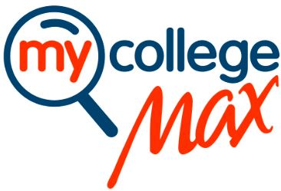

WNY Consortium of Higher Education
Points of Educational & Cultural Disconnect
©2015, Must secure permission to reproduce. MyCollegeMax™
High School Teachers vs. College Professor
Learning Environment Differences
Grading and Academic Differences
Academic and Emotional Support Differences
www.MyCollegeMax.com

Slide 17
WNY Consortium of Higher Education
Teachers versus College Faculty ©2015
High School Teacher College Professor
*Usually have a master’s degree *Usually have a doctoral degree
*Overall, teaching is their top priority *Professors have multiple responsibilities
with teaching being just one
*Classes are about 30 students *Classes can include 100’s of students
*Teachers strive to help every student achieve *Professors strive to ensure all students
understand the content. If not, it’s their
ethical responsibility to fail a student
*Teachers are held accountable for student *Professors are held accountable for
performance research, publications, service,
presentations, and also teaching
*Learning is a collaborative effort *Professors assume that students want
to learn the subject because they chose
the class. Learning is therefore up to the
student.

Slide 18
WNY Consortium of Higher Education
Learning Environment Differences ©2015
High School College
*Students attend school for 180 days *College classes usually last about 15 weeks
*High schools (HS) use progressive grading *In college, every test is an exam
*Teachers will often remind you of pending *College is not set up to “remind” students.
deadlines and test dates Students are responsible for that!
*Each time you are asked to do something *Sometimes students are asked to do things
in HS, it is checked and/or you receive a grade just for the learning experience…no grade
*Classes are designed to meet state standards *For the most part, professors define their
syllabus, student work, and grading
*Teachers help students who miss class and *If you miss class, it’s your job to get
often work with parents caught up. Usually, you need to seek the
help of your classmates. Professors have
limited time to help students.
*Teachers often provide rubrics *Professors do not tell students what they
expect in a paper nor do they expect to
have to grade grammar

Slide 19
WNY Consortium of Higher Education
Grading and Academic Differences ©2015
High School College
*HS grading is frequent and progressive *College grading is less frequent and often
cumulative (4 tests/25 pts/100 total=grade)
*Grading is designed to keep close track of *Grades are not designed to assess if you
who is “getting it” and who is falling behind are keeping up.
*Tests are designed to evaluate progress on *Colleges give cumulative exams which
several chapters and often not cumulative means everything already taught is game!
*Teachers often provide study outlines and *Professors teach during class time and
devote class time to review for tests often do not do reviews during class
*Most activities in HS are graded if they are *Professors will often recommend different
assigned by the teacher things that might not be graded but are
fair game on an exam
*Teachers often provide extra credit *While its not unheard of, most professors
do not provide extra credit
*HS’s strive to have everyone graduate *While professors want everyone to graduate,
they are not resistant to failing students

Slide 20
WNY Consortium of Higher Education
Academic & Emotional Support Differences ©2015
High School College
*Every student goes to high school *A college degree is not a given
*A student’s day, from the time they enter *College students manage their own time,
the building, is managed by someone else including whether or not to skip class
*Extracurricular activities are a privilege and *You are not only encouraged to do things
you need your parent’s permission outside of class, employers expect it!
*In order to use the restroom, you have to ask *College students actually go when they want
*In many ways, HS students are like a lab *There are no bells in college. Your schedule
experiment where everything you do is is yours to successfully or unsuccessfully
controlled by a bell manage
*If you start to falter, there are several *There are no mechanisms to identify when
mechanisms and people designed to catch students need support. However, if a
you before you fall too far behind student needs supports, most colleges
offer a wide variety of supports/counselors
*You are fully supported by the adults in your *You are fully responsible for your own
life success

Slide 21

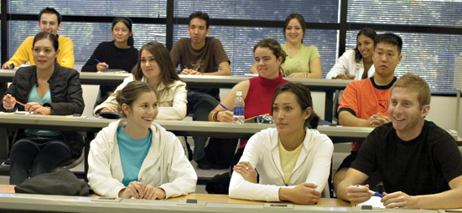


WNY Consortium of Higher Education
Today’s Greatest Challenge: Student’s Lack Motivation
Week #1 – 50 students
Week #5 – 50 students

Slide 22



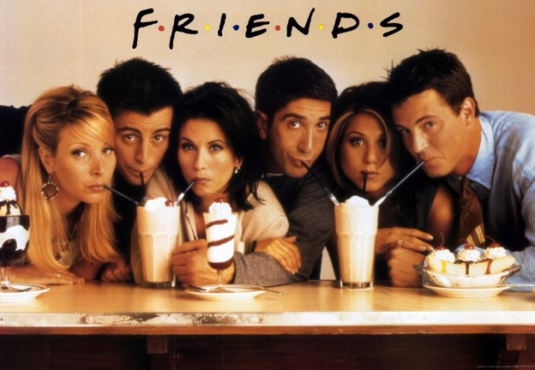

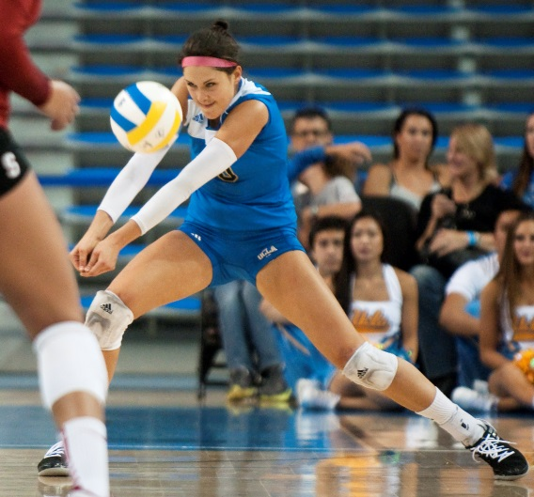

WNY Consortium of Higher Education
We ALL do it!

Slide 23
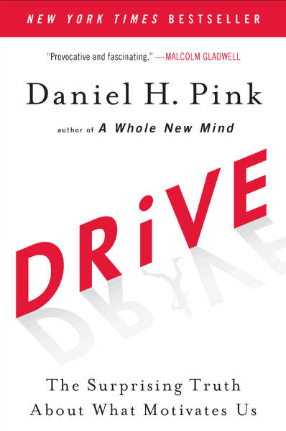
WNY Consortium of Higher Education
Personal Leadership
How do we address motivation: Daniel Pink, Drive
“Human motivation is largely intrinsic.”
Autonomy: Students need opportunities to exercise self- direction or control over their choices.
Purpose: Students who find a purpose in their “work” unlock the highest level of motivation.
Mastery: Striving to reach perfection
but never reaching it (Buffett/Gates).
“These are attributes that must be present for
motivation to develop! However, HS’s and
colleges rarely provide these to students”

Slide 24



WNY Consortium of Higher Education
Addressing Educational & Cultural Disconnects
Career
High School Student

Slide 25


WNY Consortium of Higher Education
Higher Education…..Results?
Just like in
High School
Higher
Education

Slide 26
WNY Consortium of Higher Education
What needs to happen in college.
Project-based
Learning
Apprenticeships
Professional
Associations
Informational
Interviews
Student
Clubs
Internships
Co-OP
Higher
Education
Community
Volunteering
Active Learning
Conferences
Find Mentor
Apprentice
Presentations
Experiential
Learning
Resume
Trade Journals
Career
Planning
Behavioral
Interviewing
Military
Service
Research
Entrepreneurship

Slide 27
WNY Consortium of Higher Education
Students
The Art of Becoming a Success: It’s ALL about YOU!
The Secret to College Success is: I OWN THIS!
Take an inventory of ALL of your strengths and areas that YOU need to development
Find a MENTOR and learn what it means to be a successful learner
CREATE a vision of personal success around LEARNING
Find your PASSION and a sense of PURPOSE through EXPERIENCES
Develop YOUR skills through EXPERIENCES
Be PATIENT and PERSISTENT!
Focus on OUTPUTS and NOT Inputs. Focus on who you want to become and not what is holding you back.
SEARCH out information.
Be POSITIVE, HUMBLE, and never be satisfied. Seek MASTERY!

Slide 28
WNY Consortium of Higher Education
Reflection
Writing Exercise
Write your name on a sheet of paper.
Write a one sentence goal with your WEAK hand. Any goal!
Pick a person across the room without saying anything.
Put your pen on the paper and close your eyes.
Now write that person’s 1 sentence goal.

Slide 29
WNY Consortium of Higher Education
Reflection
Writing Exercise
Doing what you always do is easy.
Change is uncomfortable and not easy.
Change without understanding is nearly impossible.
Students MUST understand what they need to do in order to be successful. It will be unnatural for them and uncomfortable.
They WILL RESIST change VEHEMENTLY.

Slide 30
WNY Consortium of Higher Education
The Role of Counselors
Creating Opportunities for Students to Decide: I OWN THIS!
Have students take assessments that are easy to understand.
Encourage students to find a mentor and to actively engage him or her.
Walk students through visioning their future. YES YOU CAN DO THAT AS A TEEN!
Encourage students to go out and experience things and develop their skills through volunteering, internships, projects, competitions, associations, & other non-required activities. That’s how students will develop motivation & passion!
Help students keep things in perspective!!! Your major will NOT DETERMINE THE REST OF YOUR LIFE BUT YOUR ACTIONS WILL.
Teach kids “It’s not who you are, rather it’s who you want to be.”
Help students find information, on their own. Help them learn to be self-directed.
Students will find their passion through experiences. It CANNOT be taught. This is the school counselor’s role.
OFFER: Counselor sponsored activities, teacher trainings, bring me in for program
Don’t treat students as one group ( All Freshmen, A through H). Group students by where they want to be (college, tech education, workforce certification, etc.)

Slide 31
WNY Consortium of Higher Education
Counselors NEED to Advocate for MORE Resources and Counselors!
30% of Pre-K through 12th Grade Schools have NO Counselors (Ed Week, Dec. 13, 2016)
Nationally, there are 482 students/1 school counselor
American School Counselor Association recommends 250 student/1 school counselor (preferably 100:1 – 2013 NYS 424:1)
College Board, 2013 Study: each additional high school counselor predicts a 10 percentage point increase in 4-year college enrollment
Colorado, 2014: for every $1 invested in counseling, the state saved $20.
NACE, 2016: Meeting 1-on-1 with a school counselor to discuss college triples the chance of a student going to college
“If you put more people in antiquated roles, not much will change. But in a repurposed role, a lot can change.” Savitz-Romer, Harvard Prof. School Counseling

Slide 32
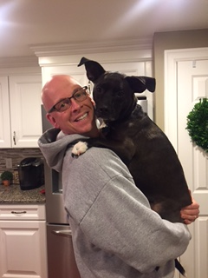
WNY Consortium of Higher Education
For more information:
www.stevenharveyphd.edublogs.org
www.wnycollegeconnection.com
www.mycollegemax.com
Questions?
Thank you!

